Slide 1
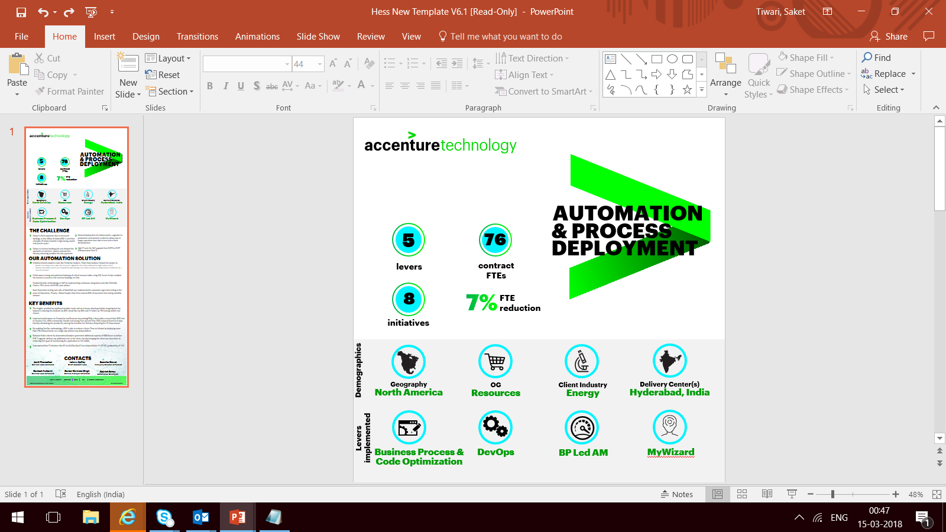
Transport Request Utility Tool
Geography
North America
Client Industry
Utilities
Scope & Tech
SAP ABAP
Delivery Center
PDC
Automation Levers
ABAP
Productivity
%
Client Benefit
$
Accenture Benefit
$
Client/Business Challenge
Our Automation Solution
Current Functionality-
SAP system provides standard Transport Organizer functionality SE09 to release, consistency check, delete and Add user. But these functionalities are limited to One TR or User at a time.
Issue Identified-
In case of multiple TR's user will have to go through a time consuming process that takes around 1 - 2 minute for each Transport request.
Assuming around 300 to 500 TRs need to be performed any of the action (Add user, Change Owner, Consistency Check, Release, Delete) it will take around 300 to 500 minutes which is approximately 4-5 hrs. to complete the task with the redundant process.
The transport Request Utility tool will help us to perform the same job on bulk number of TR’s within a constant time independent of the number of TR’s with single navigation screen,.
This tool will enables us to check, simulate, changing ownership of tasks/TRs, add users, deleted Tasks/Subtasks, check transport logs and release bulk number of TRs within 2-5 minutes.
Attached document contains the process flow chart and the human effort savings graph.

Slide 2

Key Benefits realized
CORE TEAM & CONTACTS
Features | Benefits
Release | User will be able release multiple Transport requests in a single go, which will save 100’s of minutes in case of large TR list
Add user | User will be able to add multiple users on multiple TR’s in a single go.
Change Owner | Provides the interface to change the ownership of multiple TR’s in one screen which leads to time saving
Consistency Check | Consistency Check of the TR’s in one go
Delete | User will be able to remove the TR’s/Sub-TR’s from a single screen
Child TR’s Only | Provides the functionality to select only child TR’s of the input
Uncheck/De-select | User will be able to select the list of TR’s along with child TR’s from one single click.
Transport Logs | With the single click user will be able to generate the transport logs of multiple TR’s, which again will save time by avoiding redundant process on each TR
Ent Id
Ent Id
Managing Director
Vimal Singh
Manager
p.vaz
Ent Id
Core Innovator & Developer
Neeraj Katiyar

